Slide 1



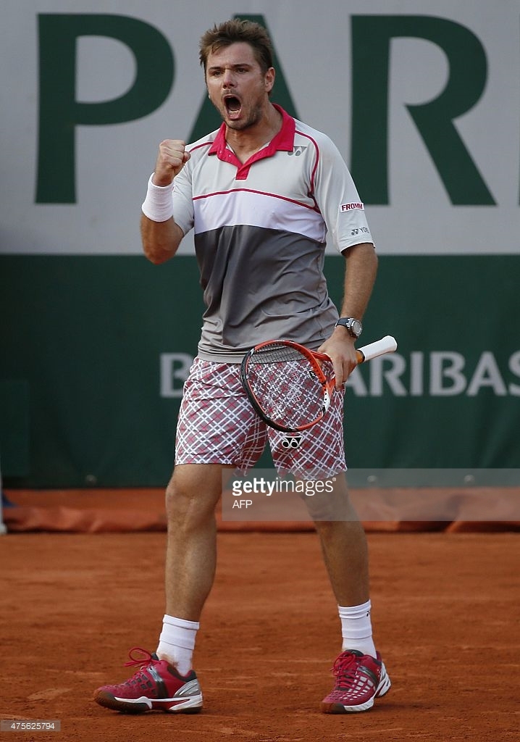

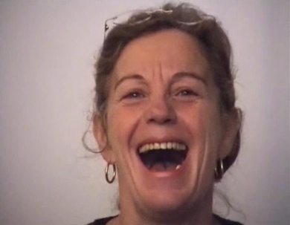
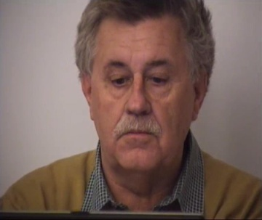

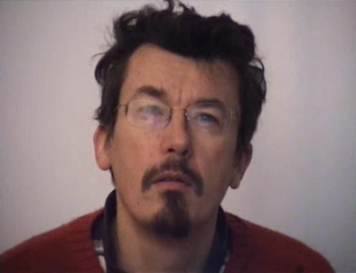

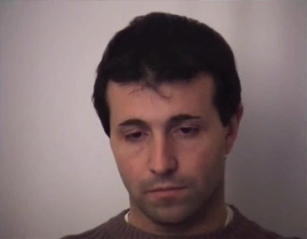

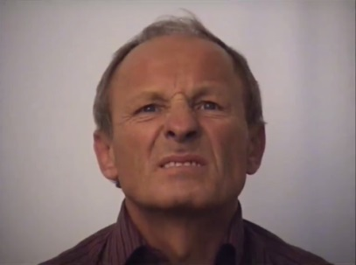

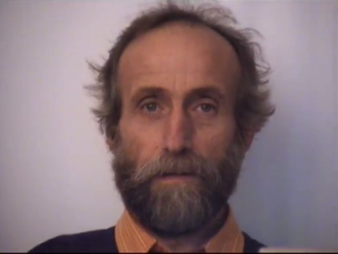

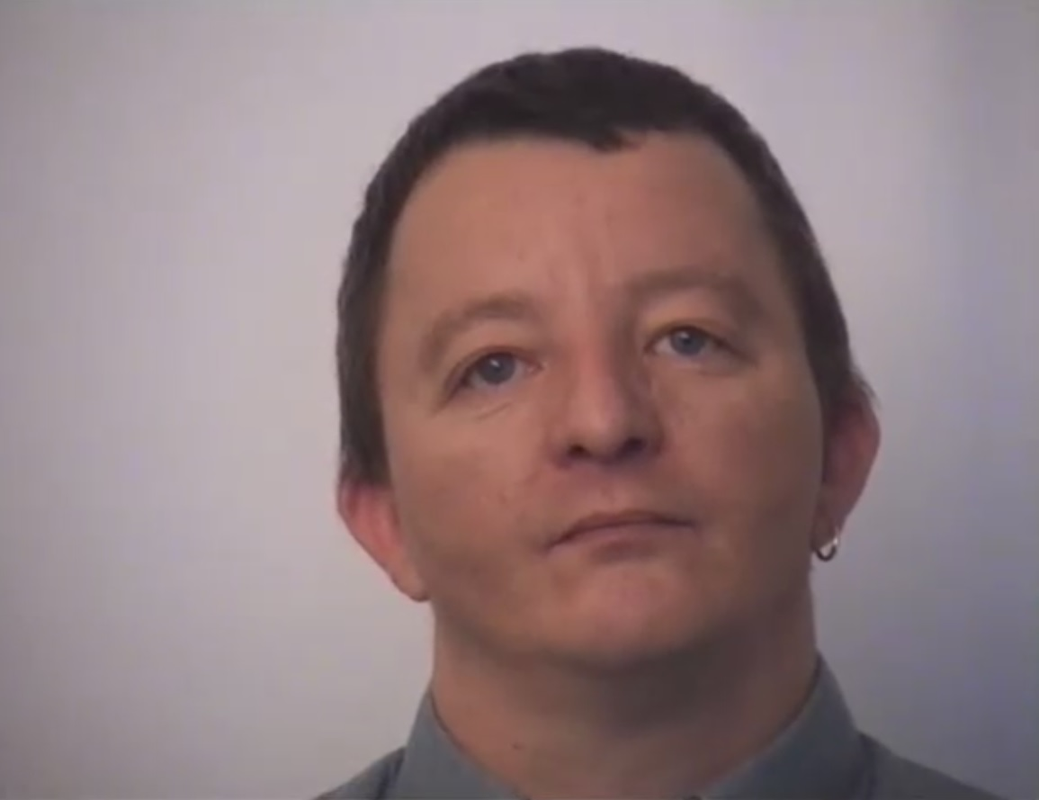



Recognition of action readiness in natural facial expressions
Damien Dupré & Anna Tcherkassof
Laboratoire Interuniversitaire de Psychologie, Univ. Grenoble Alpes, France
Damien.Dupre@upmf-grenoble.fr
Anna.Tcherkassof@upmf-grenoble.fr
Introduction
According to Frijda (1986, 2007), emotions can be described in terms of action readiness, i.e. the manner in which a person relates to her/his environment. Previous studies have shown that different action readiness states indeed present distinct relations to the various emotions categories. In this perspective, expressive behaviors are considered as actions aiming at implementing such person-environment relationship and are recognized as such.
Which action readiness is displayed?
Empirical data support the assumption that facial expressions of emotions (FEE) express states of action readiness. However, so far, the recognition of action readiness has been studied with prototypical facial expression (e.g. Tcherkassof, 1999; Scherer & Grandjean, 2008). The aim of the present research is to extend these findings to natural FEE. We expected people to be able to assign target action readiness states to dynamic and spontaneous FEE.
I wanted to keep something out of my way, to keep it at a distance.
I wanted to oppose, to assault; hurt or insult.
I wanted to go against an obstacle or difficulty, or to conquer it.
I stood above the situation; I felt I was in command; I held the ropes.
Stan Wawrinka won the French Tennis Open in 2015
Method
14 excerpts (10s long) of natural facial expressions were taken from the DynEmo database (Tcherkassof, Dupré, Meillon, Mandran, Dubois & Adam, 2013). These excerpts display male and female expressions of happiness, astonishment, interest, boredom, disgust, fright, and neutral expressions (preliminary experiments were conduct to ensure their emotional meaning).
146 participants from the university of Grenoble (24 males and 122 females, M_{age} = 21) were asked to assess those excerpts on 7 action readiness items chosen to be significantly related to those emotions (Frijda, Kuipers & TerShure, 1989). The action readiness items were rated on 5-points agreement scales from “not agree at all” to “strongly agree”.
Emotions | Corresponding Action Readiness
Happiness | Laughter
Astonishment | Interrupted
Interest | Attending
Boredom | Disinterest
Disgust | Rejection
Fright | Avoidance
Neutral (control) | Rest
Expected different action readiness states in relation to the corresponding facial expression of emotion.
Screenshot of the stimuli used:
Happiness
Astonishment
Interest
Boredom
Disgust
Fright
Neutral
Results
A comparison using contrasts (the target stimuli compared to the others) was performed. The descriptive mean results of agreement scales are the following:
Results show that 5 action readiness states are more attributed to the target stimuli than to the others.
The difference for Attending and Interrupted between the target and the others FEE is not significant.
Indicates significant contrasts p < .05
Coda
This study offers support to the idea that natural FEE are expressive behaviors implementing person-environment relationships and that these action readiness states are inferred by observers. Results show that participants successfully associate the expected states of action readiness with the corresponding natural FEE. The exception of Attending is probably linked to the elicitation conditions in which the FEE stimuli have been collected. The eliciting conditions required encoders to look at emotionally inducing films. Therefore, their main activity, intrinsically, was to attend, whatever the emotion to be induced. Clearly, observers have recognized this action readiness state in all displayed FEE because it is common to all the stimuli. Regarding Interrupted, further research is needed to understand why this action readiness state was not associated to expressive behaviors of Astonishment.
It appears that FEE are not identified as mere movements arbitrarily linked to emotion categories. Instead, FEE are recognized by reading off meaning from facial actions that are already meaningful in terms of action readiness. Further investigation with natural facial expressions of emotions is needed to validate this interpretation.
International Society for Research on Emotion
July 8 – 10, 2015, Geneva, Switzerland
Access to the DynEmo database
https://dynemo.upmf-grenoble.fr/

