Slide 1


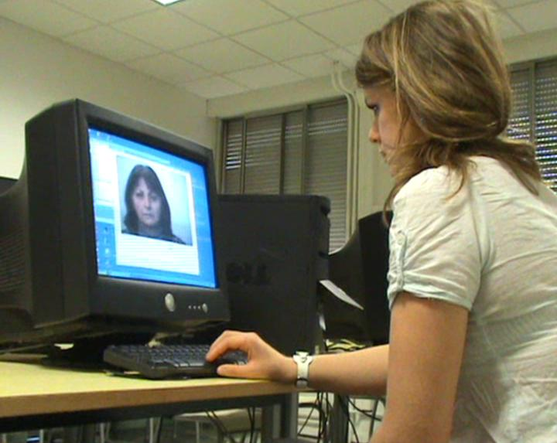
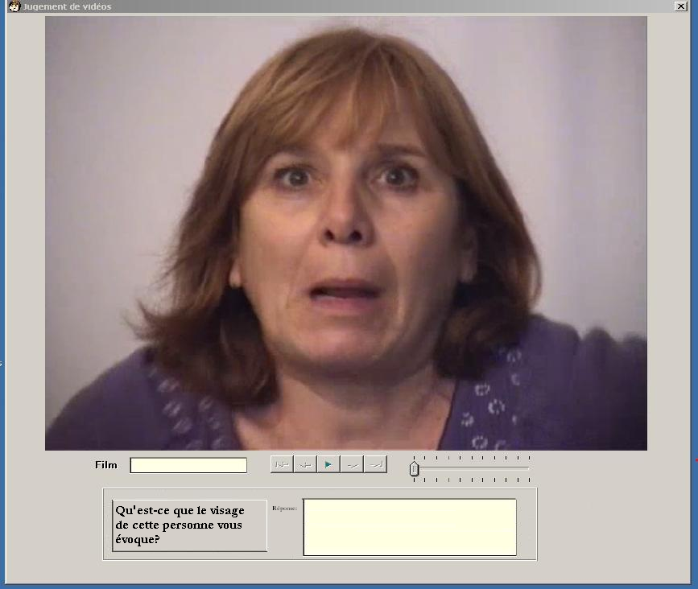
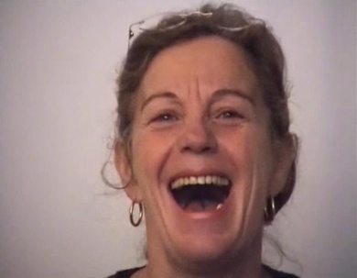
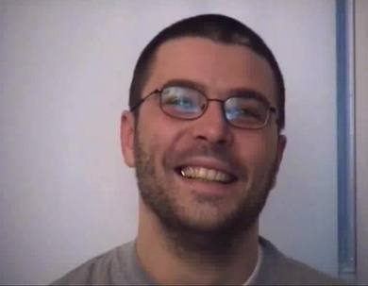
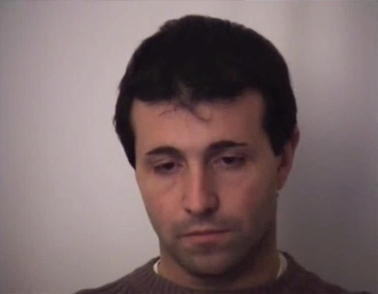
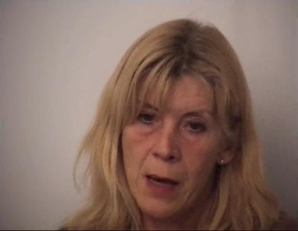
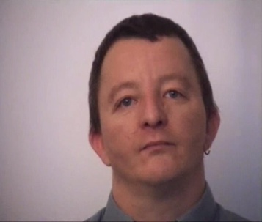
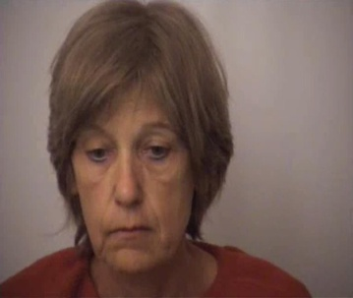
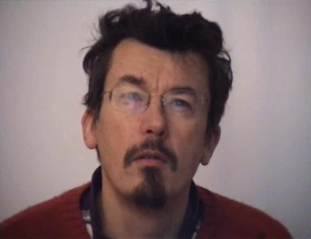
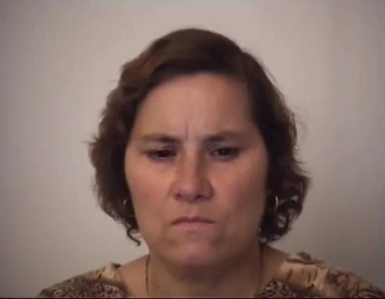
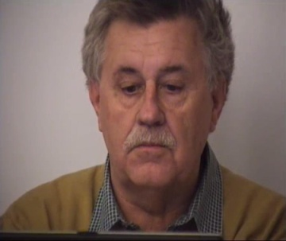
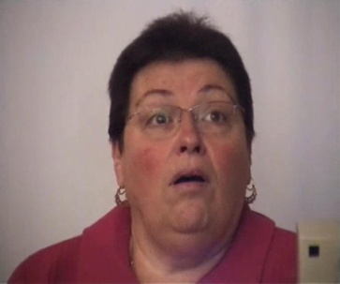
“D’you know what I mean?”
Interpretation of dynamic and spontaneous facial expressions
Damien Dupré & Anna Tcherkassof
LIP PC2S, University of Grenoble, France
Damien.Dupre@upmf-grenoble.fr
Anna.Tcherkassof@upmf-grenoble.fr
Introduction
Empirical evidence support each of these theories (Yik & Russel, 1999; Horstmann, 2003; Scherer & Grandjean, 2008). However several methodological critics flaws weaken their results.
Firstly, the use of a forced choice paradigm for facial recognition implies not only an artificial recognition agreement but also an artificial choice which could not appear if a “none of these” category was used, among other things.
Secondly, the use of posed and static facial expressions as stimuli may bias the facial interpretation (static and posed stimuli are easier to recognize because they are chosen to be prototypical).
Thus to compare the prediction of these 4 theories we choose to study the interpretation of dynamic and spontaneous EFEs with a free recognition paradigm.
How are emotional facial expressions (EFEs) interpreted? The answer varies according to theories:
For emotional theory, EFEs are interpreted with basic emotional labels;
For cognitive appraisal theory, people are able to interpret appraisals driven by the face;
For action readiness theory, EFEs express behavioural readiness;
For behavioural ecology view, facial expressions reveal social messages.
Method
1. Stimuli: dynamic and spontaneous EFEs
3. The categorization of the free interpretations
10 stimuli were chosen from the DynEmo database (https://dynemo.liglab.fr/ see also Meillon et al., 2010). They consist in faces of naïve participants covertly videotaped while carrying an emotion-inducing task.
Each video EFE was described by 47 words or sentences.
The 10 stimuli display 5 facial emotions (as self-reported: cheerfulness, interest, astonishment, boredom and a neutral expression), with a male and a female for each expression. Each stimuli lasts 10 seconds.
In order to classify them in a theoretical category (basic emotion, cognitive appraisal, social message or action readiness) plus a “none of these” category (Fig. 3), 150 students were asked to assess them in a pencil paper experiment (10 groups of 15 students).
2. Free recognition paradigm
Answers/Categories | Cognitive Appraisal | Action Readiness | Social Message | Basic Emotion | Other
Anxiety | ❑ | ❑ | ❑ | ❑ | ❑
Joy | ❑ | ❑ | ❑ | ❑ | ❑
He is surprised by what he sees | ❑ | ❑ | ❑ | ❑ | ❑
Ambiguity with regard to gender | ❑ | ❑ | ❑ | ❑ | ❑
She tries to smile to hide her sadness | ❑ | ❑ | ❑ | ❑ | ❑
An unemployed person who will pass a job interview | ❑ | ❑ | ❑ | ❑ | ❑
She doesn’t look very nice | ❑ | ❑ | ❑ | ❑ | ❑
Forty-seven participants (42 females and 5 males students) were asked to freely indicate after each EFE displays what the face expressed (Fig. 1 & 2).
Figure 1. Experimental context for free recognition of dynamic and spontaneous EFE
Figure 2.
The 10 stimuli were randomly display to 47 students which were asked to indicate what the face expressed
Figure 3. Assessment form for the free interpretation categorization. This sample was translate from the French. Answers are randomized so they are not related to the same EFE.
Results
Surprisingly, cheerfulness and boredom EFEs are mostly describe with emotional words whereas curiosity and astonishment with cognitive appraisal word (Fig. 4). This difference cannot be attributed to their intensity because they are equivalent in terms of intensity. Regarding neutral expression, as expected, there is no specific category for interpretation and participants used a lot of “other” responses.
The answer-categorisation task reveal that EFEs are mainly interpreted with basic emotional and cognitive appraisal words (respectively 31% and 26% of the interpretations, see Table 1). However EFEs are also interpreted with other words (19%) such as cognitive states (e.g. “thinking”, “reflecting”), psychological states (e.g. “depressed”, “anxious”) or physical descriptions (e.g. “old”, “ugly”, “alcoholic”).
Cheerfulness
Boredom
Neutral
Table 1. Overall categorization of the free interpretation
Interpretations categorized with basic emotional words
CA AR BE Emo Other
CA AR BE Emo Other
CA AR BE Emo Other
CA AR BE Emo Other
CA AR BE Emo Other
CA AR BE Emo Other
Curiosity
Astonishment
Free interpretations categorized with cognitive appraisal, emotions and other words
Cognitive Appraisal
Action Readiness
Behavioral Ecology View
Basic Emotions
Other
Interpretations categorized with cognitive appraisal words
CA AR BE Emo Other
CA AR BE Emo Other
CA AR BE Emo Other
CA AR BE Emo Other
Figure 4. Association of the stimuli with their results. Each picture is taken from an EFEs video. CA for Cognitive Appraisal, AR for Action Readiness, BE for Behavioral Ecology, Emo for Emotional Label and Other for other categories.
Discussion
The interpretation of facial expressions is a debated issue. To address questions emerging from preceding studies, we conducted a study in three steps: the recording of dynamic and spontaneous facial expressions (1.), an interpretation of these EFEs with a free recognition paradigm (2.) and the categorization of these interpretative results (3.). This categorization indicates that EFEs are interpreted not only with emotional words but also cognitive appraisal words. Nevertheless, non-emotional categories were not expected to describe facial expressions. The use of non-emotional word is not based on visual characteristics and could lead to a fundamental attribution error (Fernandez-Dols, Carrera & Russell, 2002). Finally, it is important to note that facial interpretation is not only grounded on physical perceptions but also on belief and expectations unrelated with EFEs recognition.
CERE 2012, May 2-5, Canterbury, England
References
Fernandez-Dols, J. M., Carrera, P. & Russell, J. A. (2002). Are facial displays emotional? Situational influences in the attribution of emotion to facial expressions. The Spanish Journal of Psychology, 5, 119-124.
Horstmann, G. (2003). What do facial expressions convey: Feeling states, behavioural intentions, or action requests? Emotion, 3, 150–166.
Meillon, B., et al. (2010). DynEmo: A Corpus of dynamic and spontaneous emotional facial expressions. Multimodal Corpora, Tools and Resources: Advances in Capturing, Coding and Analyzing Multimodality, Malta, May 18.
Scherer, K. R. & Grandjean, D. (2008). Facial expressions allow inference of both emotions and their components. Cognition and Emotion, 22, 789-801
Yik, M. S. M. & Russell, J. A. (1999). Interpretation of faces: A cross cultural study of a prediction from Fridlund’s theory. Cognition and Emotion, 13, 93-104.

